Slide 1
Bird Strike Analysis

Slide 2
Problem Statement
Transport and communication is one of the crucial domain in field of analytics. Environmental impacts and safety are, nowadays, two major concerns of the scientific community with respect to transport scenarios and to the ever-growing urban areas. These issues gain more importance due to the increasing amount of vehicles and people. Seeking for new solutions is reaching a point where available technologies and artificial intelligence, especially MAS, are being recognized as ways to cope and tackle these kinds of problems in a distributed and more appropriate way. A bird strike is strictly defined as a collision between a bird and an aircraft which is in flight or on a take-off or landing roll. The term is often expanded to cover other wildlife strikes - with bats or ground animals. Bird Strike is common and can be a significant threat to aircraft safety. For smaller aircraft, significant damage may be caused to the aircraft structure and all aircraft, especially jet-engine ones, are vulnerable to the loss of thrust which can follow the ingestion of birds into engine air intakes. This has resulted in several fatal accidents. Bird strikes may occur during any phase of flight, but are most likely during the take-off, initial climb, approach and landing phases due to the greater numbers of birds in flight at lower levels. To have a closer look the following document visually depicts the data collected on Bird Strikes by FAA between 2000-2011.

Slide 3
Import Data And Required Packages
import pandas as pd
import numpy as np
import matplotlib.pyplot as plt
import seaborn as sns
import plotly.express as px
import warnings

Slide 4
Data Cleaning and Manipulation
The first stage in any EDA problem solving strategy is Data cleaning and Manipulation stage.
Data Cleaning and Manipulation Steps
Data Understanding
Reading Dataset documentation Importing data - understanding each column data Data Summarisation like Check data type of columns, number of rows etc. Data Cleaning
Dropping irrelevant columns Renaming the columns Dropping the duplicate rows Dropping or handling missing values Dropping invalid data rows (Also check if column have correct data type) Detecting and handling outliers (this can be handled in data analysis part as well) Data Manipulation
Column transformation Joining datasets other manipulation like pivoting or transposing (this is also applied in data analysis part)

Slide 5
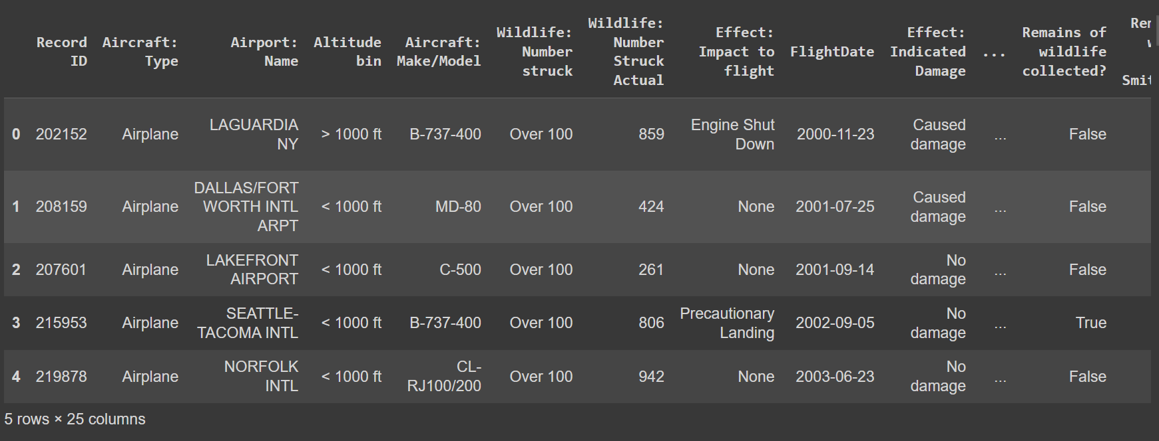
After uploading our data set in google collab by using pandas lib we can see how our data actually look like

Slide 6
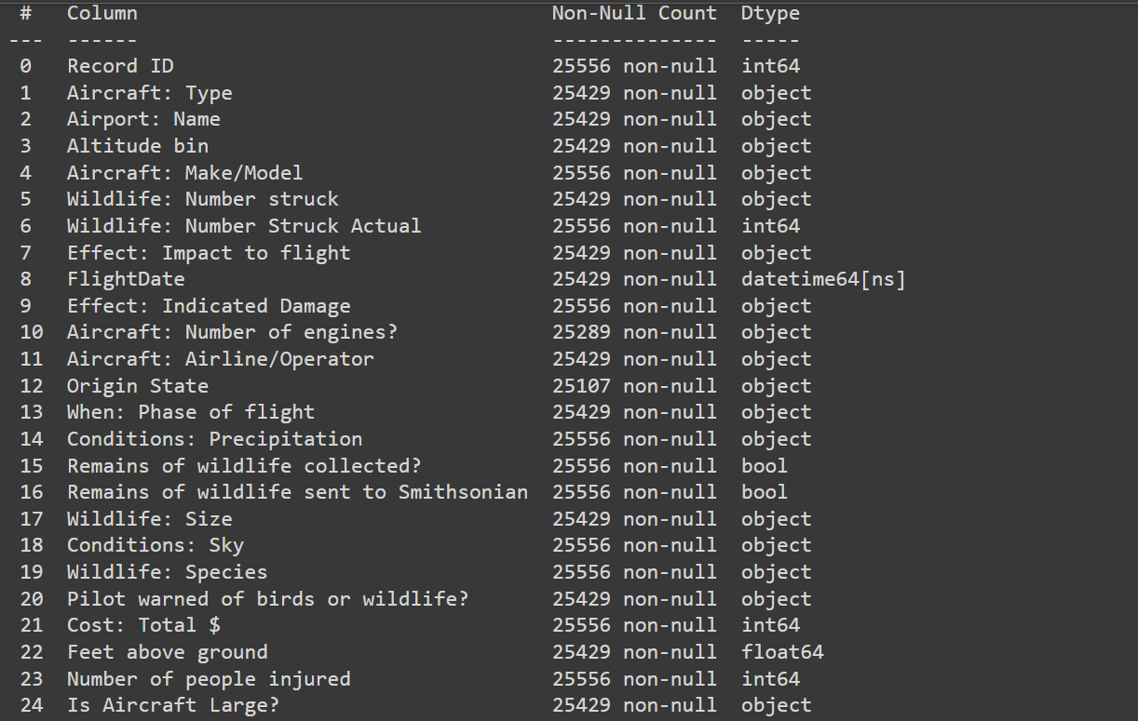
Data Summarisation
What is the shape of the data which means how many row and columns are present in the data it can be done by using pandas.shape
To get the information about the data that is the any null value present in the data or what type of value a column hold

Slide 7
Data Cleaning Required
Drop the Duplicate Values
Drop unnecessary Columns
Fill missing Values
Change data or Time Columns in particular style
Apply some Standarization method to deal with over and underfitting problems
Apply Column Transformation if Required

Slide 8
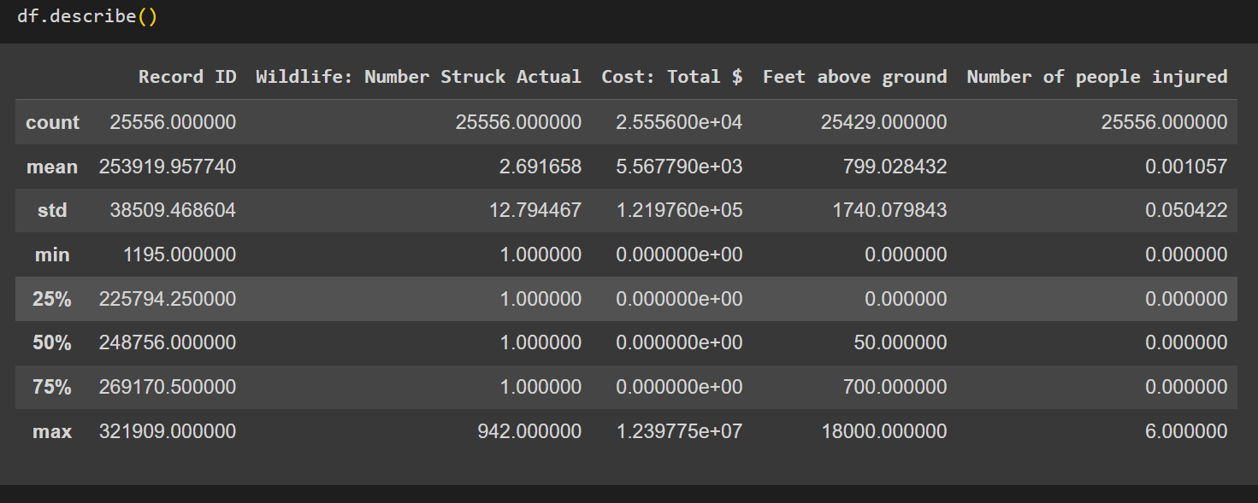
Describe everthing between numerical column in the data set

Slide 9
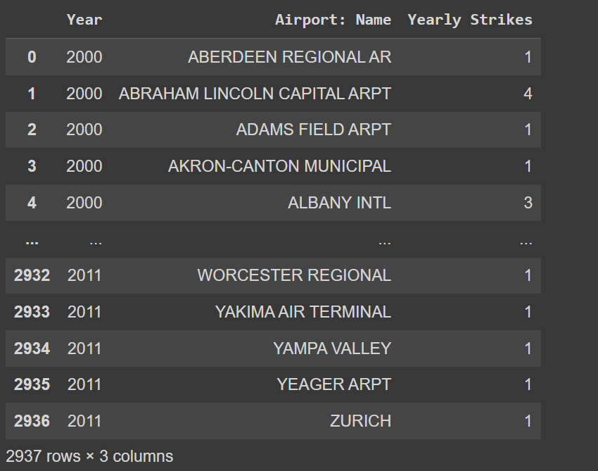
YEARLY STRIKES ON AIRPORT BASED ON AIRPORT

Slide 10
Data Visualization:
To be a successful leader in the modern finance workplace, you need to be fluent in data analysis and visualization. Data visualization tools help you quickly compare large volumes of data and easily identify patterns that aren’t immediately available in blocks of text. Good data visualization also makes it easier to communicate detailed concepts to other people.¹
There are many ways to share your information as graphical representation—histograms, bar charts, heat maps, pie charts, tree maps, box plots, and word clouds, among others—so you have lots of options when it comes to presenting complex data to diverse audiences.² Keep reading to explore the techniques and tools involved in data analysis and visualization.

Slide 11
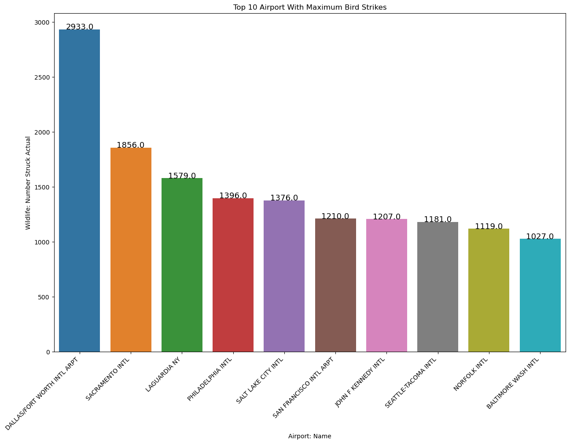

Slide 12
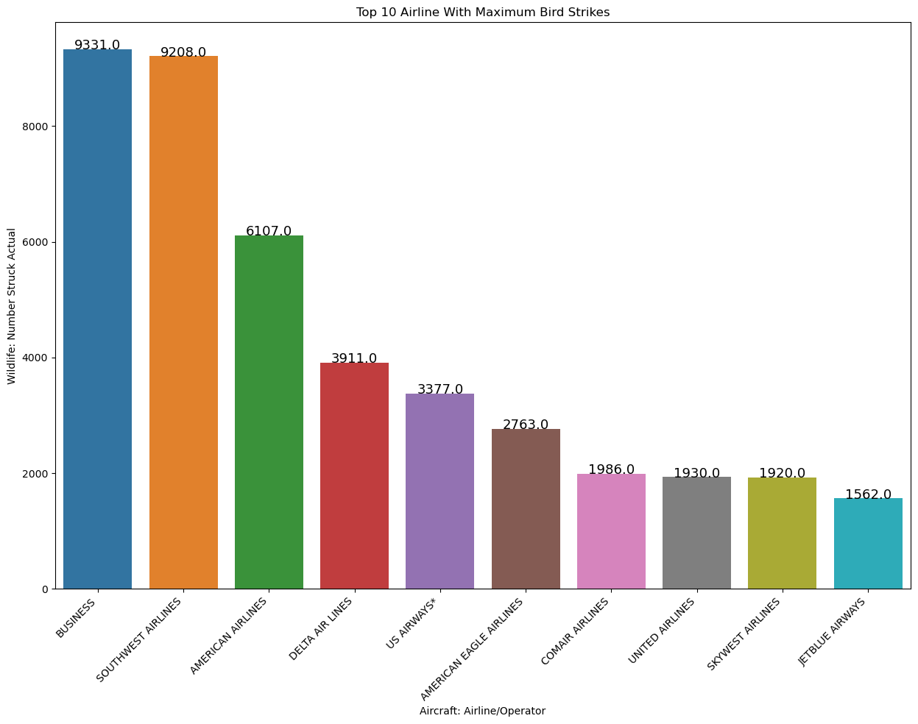

Slide 13
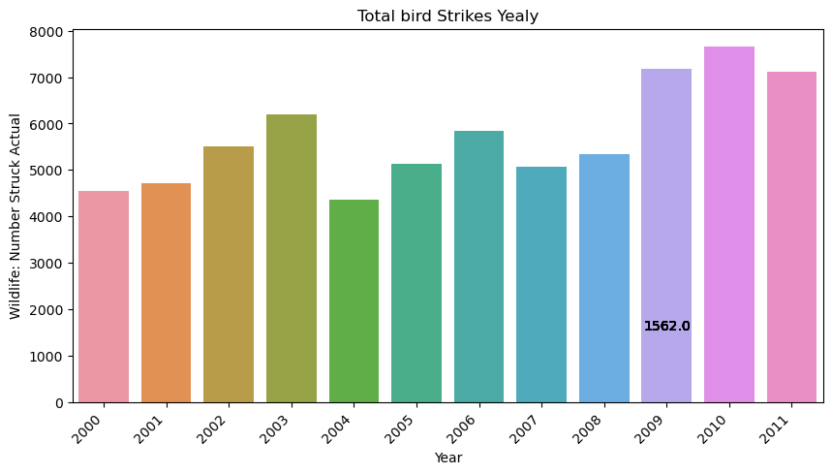

Slide 14
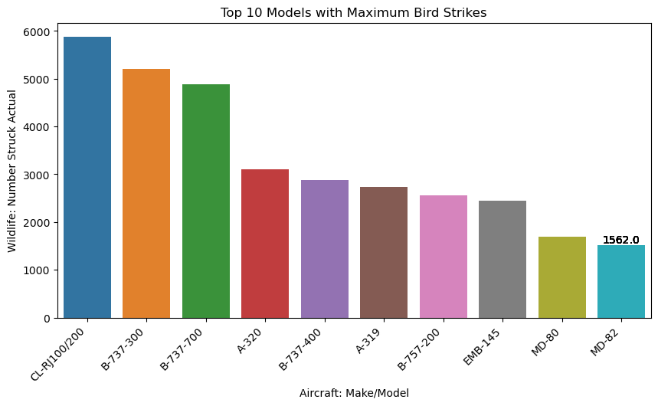

Slide 15
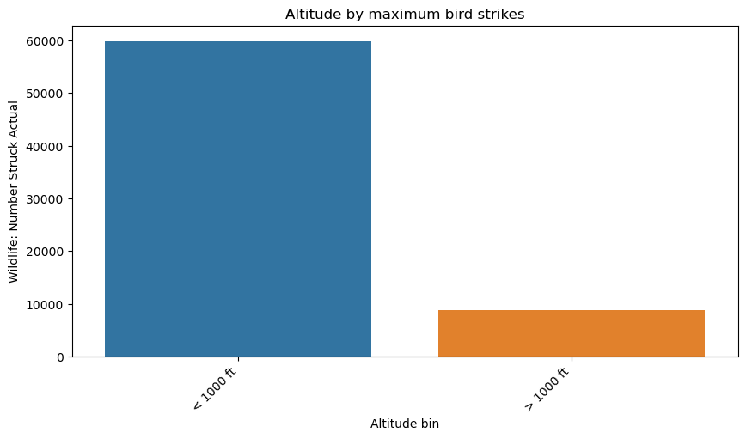

Slide 16
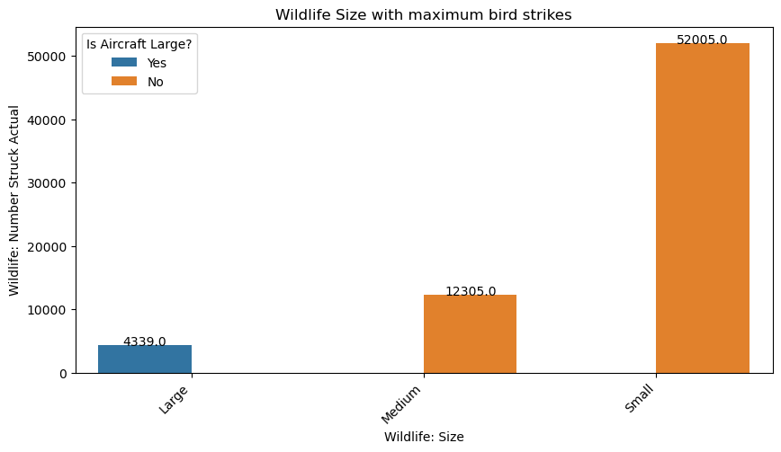

Slide 17
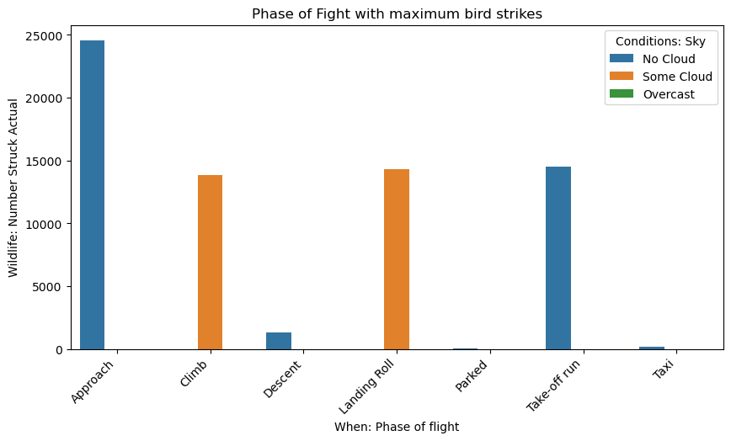

Slide 18
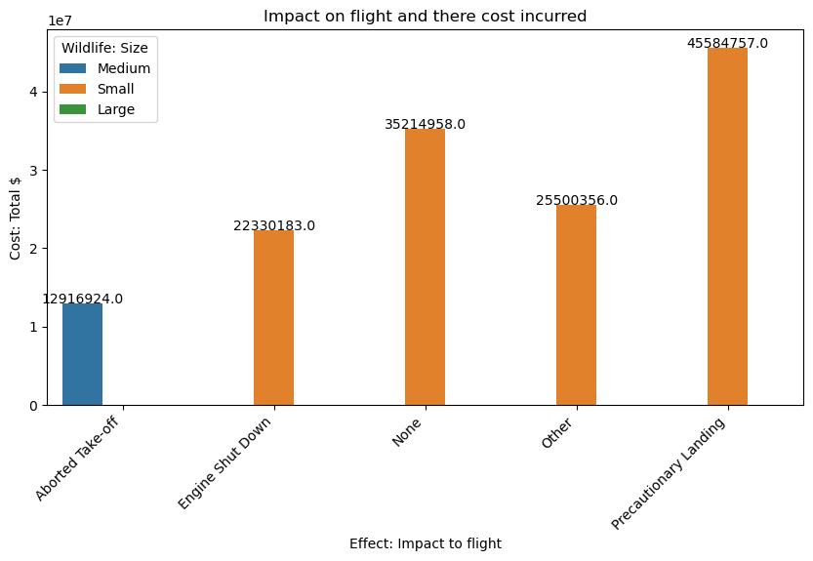

Slide 20
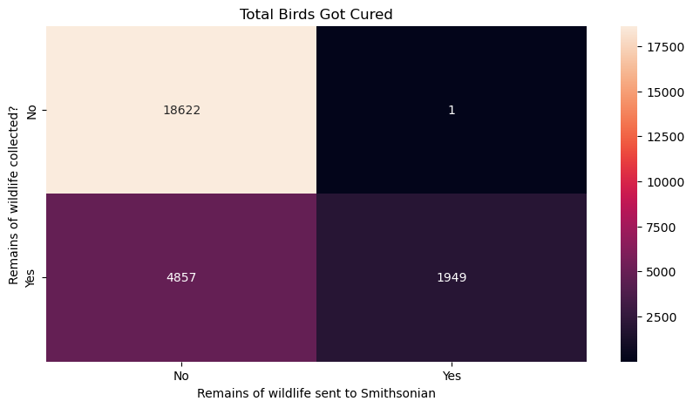

Slide 21
THANKING YOU

